Slide 1
Cursul 13
Exemple de sisteme adaptive complexe in economie

Slide 2
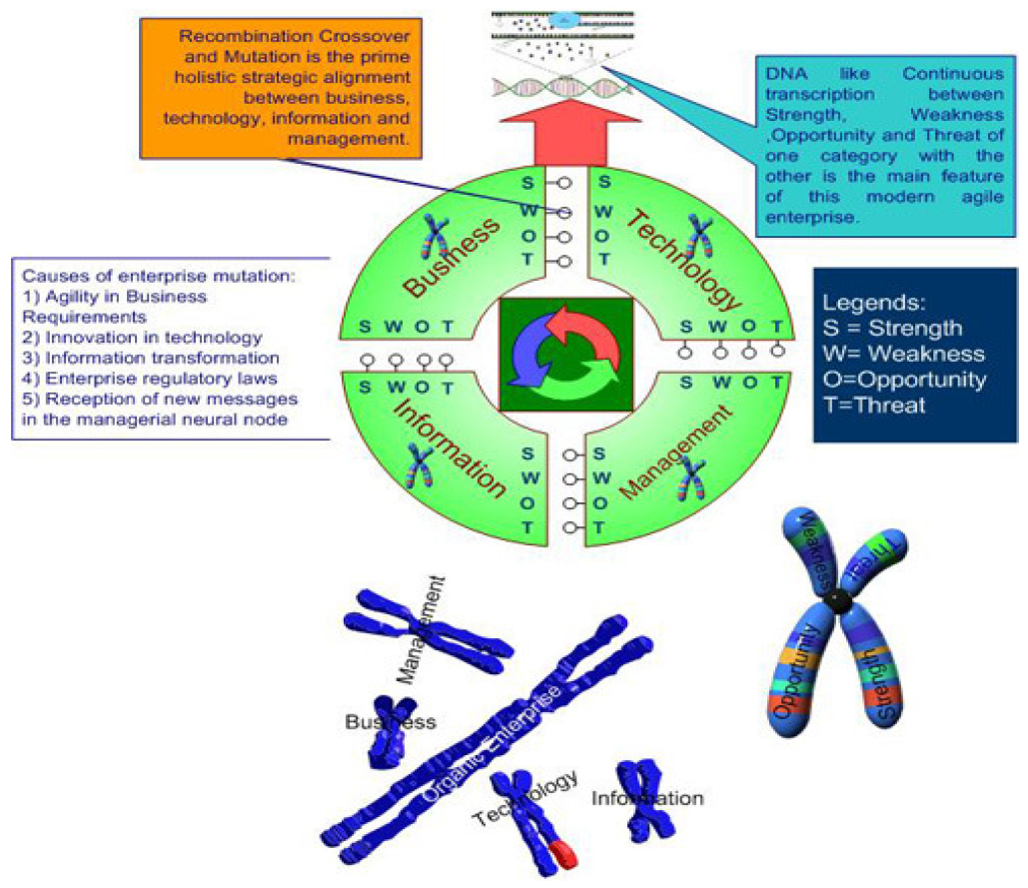
FIRMA

Slide 3
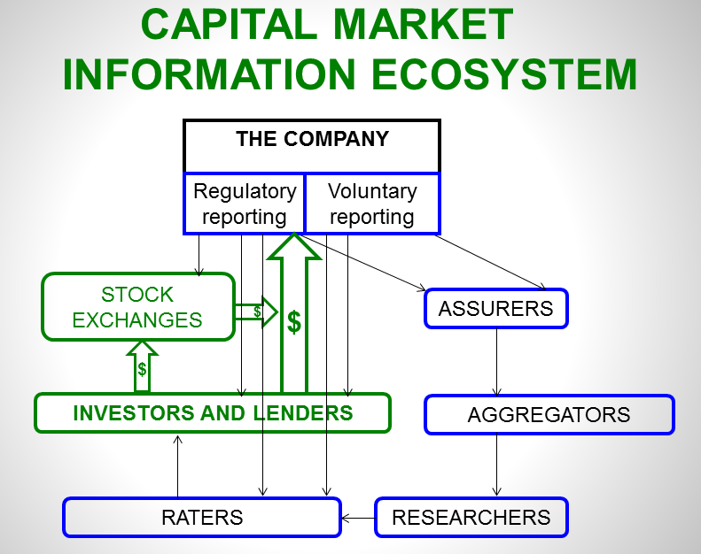
PIATA DE CAPITAL

Slide 4
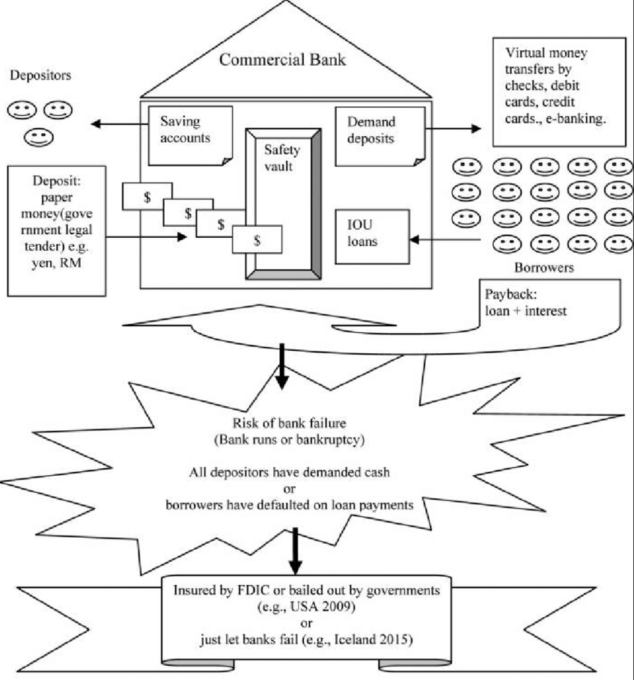
BANCA

Slide 5
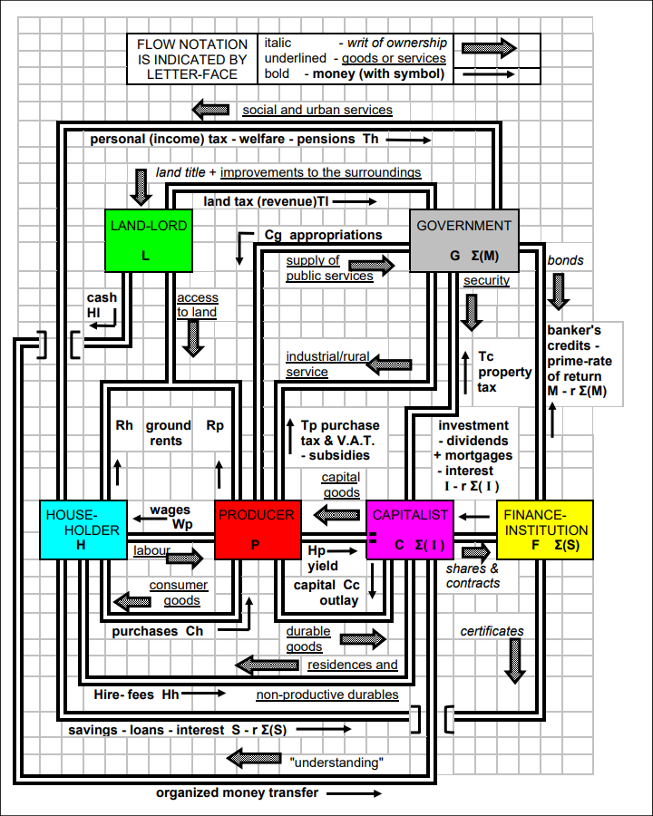
ECONOMIA
NATIONALA

Slide 6
VSM (Viable System Model)
Stafford Beer

Slide 7
Link-uri utile
VSM (Viable System Model) Stafford Beer
Explicatii VSM

